Slide 1
Integrating KNN and QoS for Improved Resource Management in 5G Networks
Sakthivel R
Reg No: 325150041
II M.Sc. Data Science
Guide:
Dr.Rajesh P,
Assistant Professor - II,
Department of Data Science,
SASTRA Chennai Campus.

Slide 2
Base Paper Details
Title of the Publication: Joint QoS and energy-efficient resource allocation and scheduling in 5G Network Slicing
Journal: Computer communication
Authors: Saibharath S.a,Sudeepta Mishrab ,Chittaranjan Hota
Publication: 2023
Indexing Details: SSCI
Other Relevant Information: The paper focuses on using CC for scheduling resources in edge networks, with a focus on user satisfaction and dynamic resource management.

Slide 3
Problem Statement
The work focuses on improving resource allocation in 5G networks by classifying network slices using KNN based on network quality. It dynamically adjusts QoS and allocates bandwidth in real-time, based on the predicted network slice class and traffic demand, ensuring efficient and responsive resource management for high-demand applications.

Slide 4
Objectives
The primary objective of this work is to develop an efficient and adaptive resource allocation framework for 5G networks through the classification of network slices based on real-time Quality of Service (QoS) metrics. This framework aims to:
Optimize Resource Allocation by slicing a network slice
Enhance Quality of Service (QoS) by priority wise allocation
Integrate Machine Learning Techniques
Improve Network Efficiency by balanced resource allocation between static and dynamic environment
Real-Time Analysis and Implementation by working on data collected on real time

Slide 5
Literature Review
Title | Journal | Findings
Harris Hawks optimization based hybrid deep learning model for efficient network slicing in 5G network | Cluster Computing (2024) | proposes a hybrid network slicing model combining HHO optimization with a CNN-LSTM deep learning model (HHO-CNN-LSTM) for hyperparameter tuning and classification of network slices in 5G and 6G networks.
Efficient Network Slicing for 5G Services in Cloud Fog-RAN Deployment Over WDM Network | IEEE Transaction On Vehicle Technology | The paper finds that the new 3-layer CF-RAN architecture improves network efficiency by centralizing 70% more baseband units and reducing request blocking by 50% compared to the traditional 2-layer design.
Intelligent Resource Management for eMBB and URLLC in 5G and Beyond Wireless Networks | Digital Object Identifier(2023) | The paper finds that using a puncturing technique with semi-supervised learning and DRL enables efficient resource allocation in 5G networks, ensuring low latency and reliability for URLLC and throughput for eMBB services. improves resource utilization

Slide 6
Title | Journal | Findings
Edge Computing Resource Allocation Method for Mining 5G Communication System | Digital Object Identifier(2023) | Using MEC with edge caching and dynamic resource allocation in 5G underground coal mine networks reduces task execution delays by 50%, improves transmission rates (1 Gbps uplink, 1.5 Gbps downlink), and enhances communication reliability and resource efficiency.
Deep Learning for Intelligent and Automated Network Slicing in 5G Open RAN (ORAN) Deployment | Digital Object Identifier(2023) | Using AI-driven network slicing in the RAN, enabled by the RAN Intelligent Controller (RIC) and DL, allows for automated, intelligent management of network functions.
Blockchain-Enabled Federated Learning-Based Resource Allocation and Trading for Network Slicing in 5G | ACM TRANSACTIONS ON NETWORKING | The proposed decentralized framework for network slicing, using blockchain and federated deep reinforcement learning, significantly improves resource trading and allocation among tenants.

Slide 7
Data Description
Attributes:
CellID
RSRP - signal strength
RSRQ - signal quality
Source :
sourced from a 5G trace dataset collected from a major Irish mobile operator.
Includes data from both static and car-based mobility patterns.
This dataset is publicly available at the following GitHub repository:
Reference: D. Raca, D. Leahy, C.J. Sreenan and J.J. Quinlan. Beyond Throughput, The Next Generation: A 5G Dataset with Channel and Context Metrics. ACM Multimedia Systems Conference (MMSys), Istanbul, Turkey. June 8-11, 2020
Link: UVVMIST-REALTIME

Slide 8
Methodology
Preprocessing:
Converted categorical data (e.g., network attributes) to numerical values.
Handled missing data by filling with column mean values for features like 'NRxRSRP' and 'NRxRSRQ'.
Compute Network Quality as an average of 'NRxRSRP' and 'NRxRSRQ' to classify network slices.
KNN Model:
Classified network slices into Low, Medium, and High based on network quality.
Used GridSearchCV to optimize KNN hyperparameters (e.g., neighbors, distance metric) for best performance.

Slide 9
QoS Adjustment:
Dynamically adjusted bandwidth allocation based on KNN slice classification, traffic demand, and network quality, ensuring efficient real-time resource management.

Slide 10
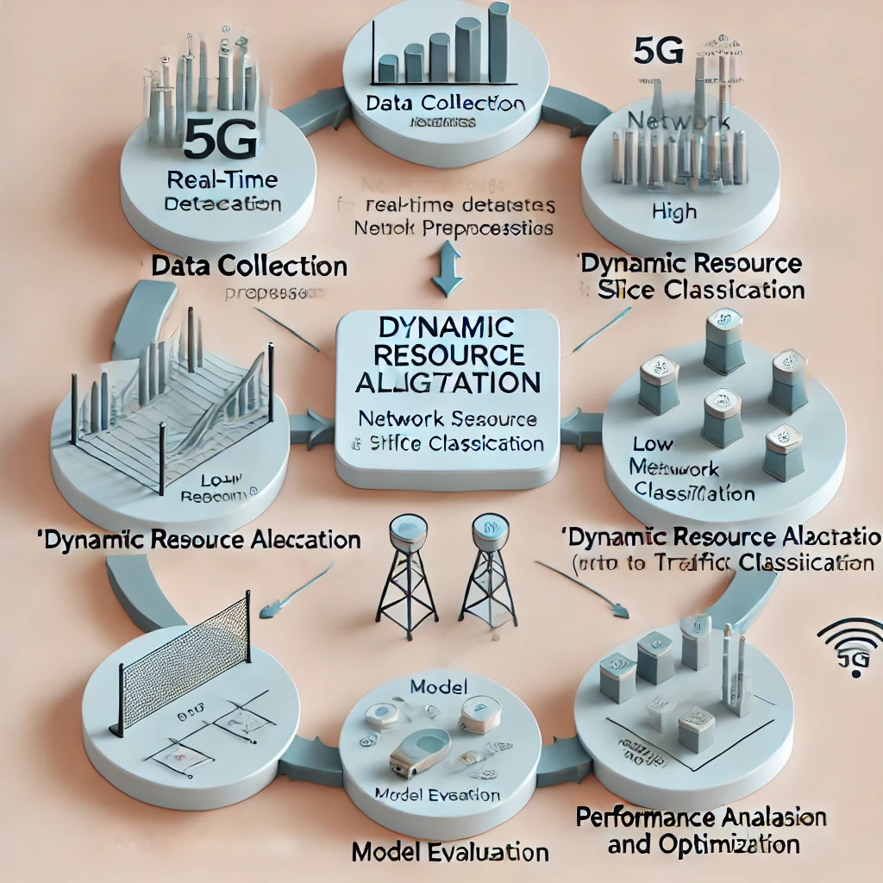
Flow diagram of this work

Slide 11
KNN Implementation and Results
Static Environment:
Best parameters: Manhattan metric, 7 neighbors, weighted distance
Accuracy: 83%
Driving Environment:
Best parameters: Manhattan metric, 16 neighbors, weighted distance
Accuracy: 91%

Slide 12
Dynamic Resource Allocation
Traffic demand is generated randomly for each slice, then resources are allocated dynamically based on the traffic demand and network quality.
Low: Base bandwidth of 50 Mbps
Medium: Base bandwidth of 100 Mbps
High: Base bandwidth of 150 Mbps
Final allocation = Base bandwidth + (Traffic Demand * Network Quality)

Slide 13
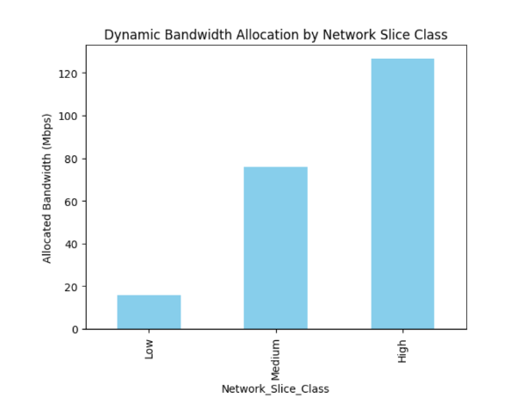
Visualization of Dynamic Allocation
The bar chart shows the average allocated bandwidth across different network slice classes after dynamic resource allocation.
The results reveal that 'High' class slices generally receive more bandwidth.

Slide 14
Novelty
Formula for Dynamic Bandwidth Allocation
The novelty lies in the use of a custom formula for real-time resource allocation, which integrates traffic demand with QoS metrics: This formula ensures that resources are allocated in proportion to real-time demand and network conditions.
Allocated Bandwidth = Base Bandwidth + (Traffic Demand * Network Quality)
Use of Real-World Dataset
Unlike many studies that rely on simulated data, this work leverages a real-world dataset collected from GitHub repositories, covering both static and mobile environments. This makes the study more relevant to practical applications.
.

Slide 15
3. Dynamic Environment Consideration
The model's performance is evaluated in both static and driving environments, capturing the impact of mobility on resource allocation. This dual-environment analysis ensures robustness and adaptability.
4. Network Slice Classification
Employing a machine learning-driven classification system for network slicing adds a layer of automation and precision to resource allocation, improving QoS for high-priority applications.
5. Real-Time Implementation
The study bridges the gap between theoretical modeling and practical deployment by validating the model on real-time datasets, showcasing its applicability to live 5G networks

Slide 16
Future work
Potential improvements include:
Implementing energy-efficient scheduling
mechanisms.
Real-time resource allocation based on user
mobility and signal quality.
Exploring more sophisticated machine learning algorithms for classification.

Slide 17
Reference
[1] Yao, Z., Cheng, W., Zhang, W., & Zhang, H. (2021). Resource allocation for 5G-UAV-based emergency wireless communications. IEEE Journal on Selected Areas in Communications, 39(11), 3395-3410.
[2] Kamal, M. A., Raza, H. W., Alam, M. M., Su’ud, M. M., & Sajak, A. B. A. B. (2021). Resource allocation schemes for 5G network: A systematic review. Sensors, 21(19), 6588.
[3] NDegambur, L. N., Mungur, A., Armoogum, S., & Pudaruth, S. (2021). Resource allocation in 4G and 5G networks: A review. International Journal of Communication Networks and Information Security, 13(3), 401-408.
[4]Jayaraman, R., Manickam, B., Annamalai, S., Kumar, M., Mishra, A., & Shrestha, R. (2023). Effective resource allocation technique to improve QoS in 5G wireless network. Electronics, 12(2), 451.
[5]Sarah, A., Nencioni, G., & Khan, M. M. I. (2023). Resource allocation in multi-access edge computing for 5G-and-beyond networks. Computer Networks, 227, 109720.
[6]Kumar, R., Sinwar, D., & Singh, V. (2023). QoS aware resource allocation for coexistence mechanisms between eMBB and URLLC: Issues, challenges, and future directions in 5G. Computer Communications.
[7]Raca, D. Leahy, C.J. Sreenan and J.J. Quinlan. Beyond Throughput, The Next Generation: A 5G Dataset with Channel and Context Metrics. ACM Multimedia Systems Conference (MMSys), Istanbul, Turkey. June 8-11, 2020

